Slide 1
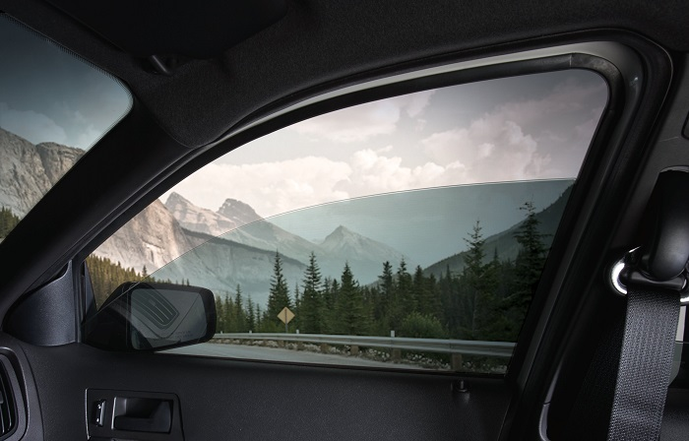
Power Window Control System
Using Tiva C & FreeRTOS
Team 17:
Anas Salah Abdelrazek 19P9033
Alaa Mohamed Hamdy 19P6621
Nada Amr Attia 19P1621
Ahmed Amr Mohyeldin Elgayar 19P8349
Mohamed Mahmoud Hussein Ahmed 19P7975

Slide 2
Agenda
Team Members Contribution
GitHub & video Link
Project Requirements
Project Approach
Overview on How our system Works
State Diagrams
Circuit Topology
Handling Different Cases Using Timing Diagrams
Uses of Semaphores , Queues and Mutex

Slide 3
Team Members Contribution
Task Assigned | Members
Planning Project Approach | All members
LCD | Nada , Alaa
Button Task | Ahmed , Anas
Driver Tasks | Mohamed , Nada
Passenger Tasks | Anas , Alaa
Sporadic Tasks | Ahmed
Hardware Connections | Mohamed , Anas
Drivers | Mohamed
Testing | All members

Slide 4
GitHub And Video Link
GitHub Repository : https://github.com/anassalah24/Power-Window-Control-System-Using-Tiva-C-And-FreeRTOS.git
(code Contains Detailed Comments)
Video Link: https://drive.google.com/file/d/19InKF6QktM48Px8oUl6x1Iapc-dWLjIn/view?usp=sharing

Slide 5
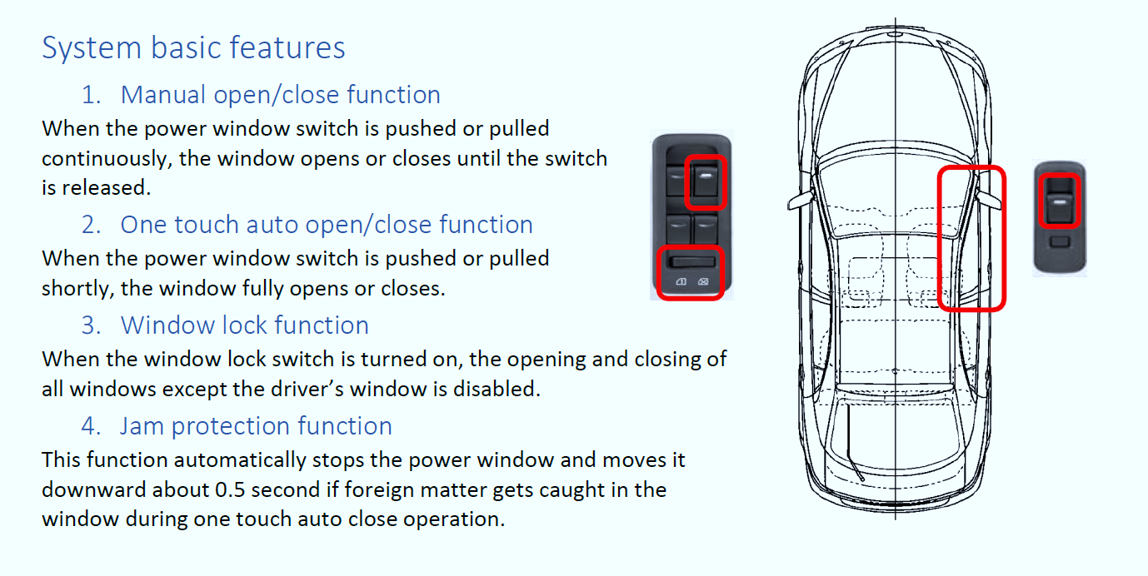
Project Requirements

Slide 6
Project Approach
Our Project Contains 4 main Types of Tasks
Tasks
Continuous Button Task | Driver Tasks | Passenger Tasks | Interrupt Handler Tasks
This Task is responsible for detecting which button (driver and passenger UP & Down ) was pressed and if it was automatic mode or manual mode | These tasks handles the driver’s up and down (automatic or manual) actions for button presses | These tasks handles the passenger’s up and down (automatic or manual) actions for button presses | These tasks handles the interrupt button presses such as Jamming , Window Lock , upper limiter and down limiter

Slide 7
Overview on How our system Works
Initially a single continuous Task (Button Task) is created with lowest priority (1) and it detects if any up or down button was pressed from either side of the vehicle (Driver or Passenger), This task is never deleted.
If a button was pressed (say the driver up) a task is created with higher priority (2) which deals with the actions needed to handle the window moving up (either manual or automatic)by the driver , after this task has finished execution, it deletes itself and CPU is returned to the Button Task.(similarly with driver down button and passeneger up and down buttons)
Similarly, if the passenger presses any button the same thing happens exactly but passengers' task have a little bit extra logic in them which is it to detects if any of the driver’s buttons were pressed because if it was (since driver has more power than passenger) we need to switch execution to driver so we create a driver task with higher priority (3) that handles its action but once we start the driver task we delete the passenger task because we don’t want to return back to it obviously.
If during execution of any of the above tasks , an interrupt driven (sporadic task) occur such as Jamming button , Window Lock , Upper and lower limiters were pressed , the above tasks are interrupted and a ISR handler tasks are executed which alters flags of the mentioned interrupt events.
NOTE : The above logic is visualized in diagrams in the next slides throughout the presentation

Slide 8
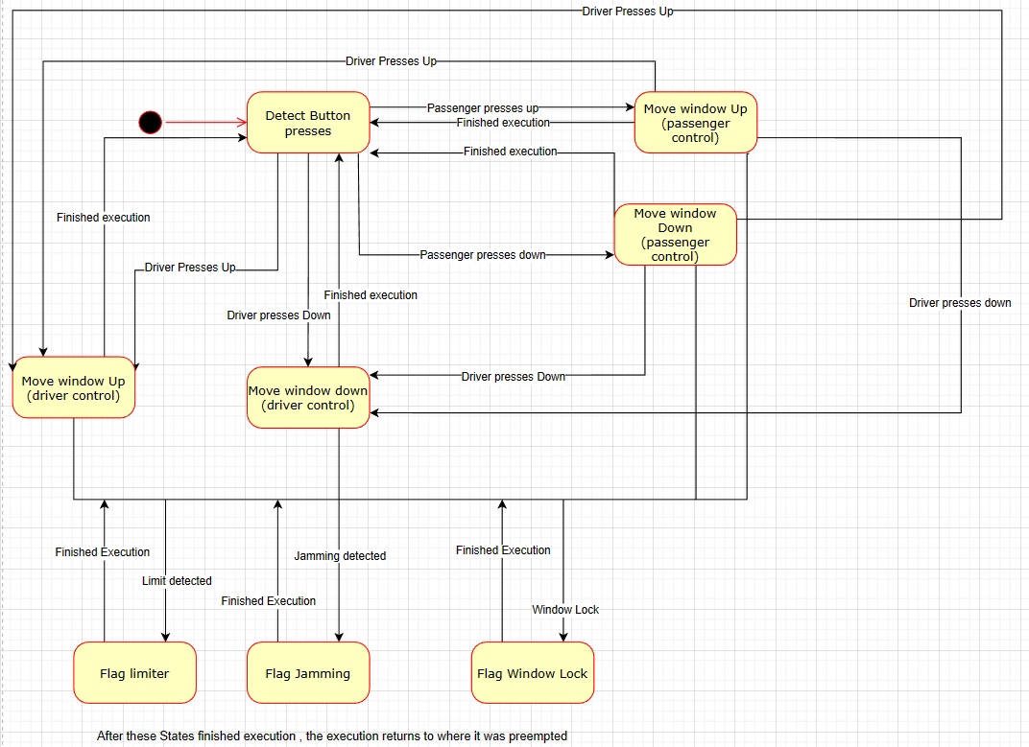
Overall
System State Diagram

Slide 9
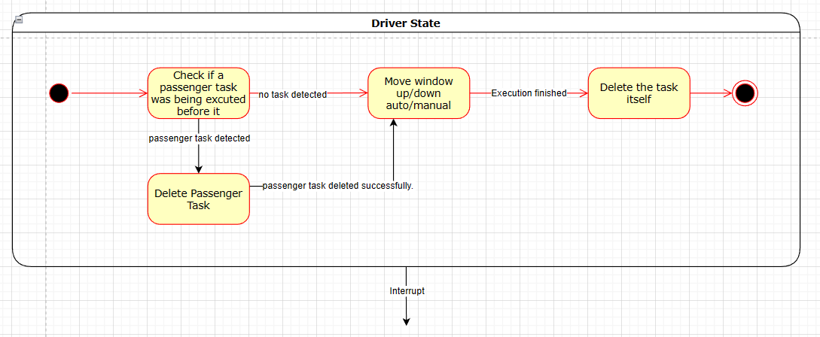
Driver State
(container Diagram)

Slide 10
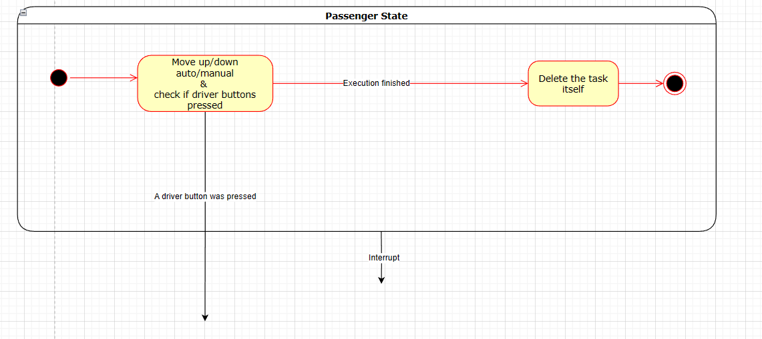
Passenger State
(container Diagram)

Slide 11
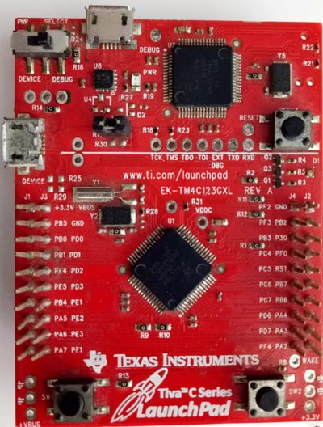
Circuit Topology
Tiva C Connections
Window Buttons (Port C)
PC4 | Driver Up
PC5 | Driver Down
PC6 | Passenger Up
PC7 | Passenger Down

Slide 12
Circuit Topology
Tiva C Connections
Interrupt Buttons (Port E)
PE1 | Upper Limit Switch
PE2 | Lower Limit Switch
PE3 | Window Lock Push Button
PE4 | Jam Detected Push Button

Slide 13
Circuit Topology
Tiva C Connections
Motor Module (Port A)
PA2 | ENA
PA3 | IN1
PA4 | IN2

Slide 14
Circuit Topology
Tiva C Connections
LCD Module (Port B)

Slide 15
Circuit Topology
LCD Connections (breadboard 1)

Slide 16
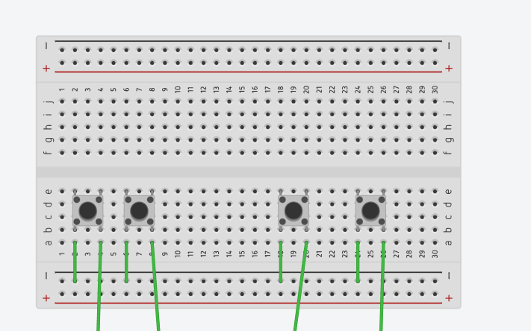
Circuit Topology
Driver and Passenger buttons Connections (breadboard 2)
Driver down
Driver up
pass up
pass down

Slide 17
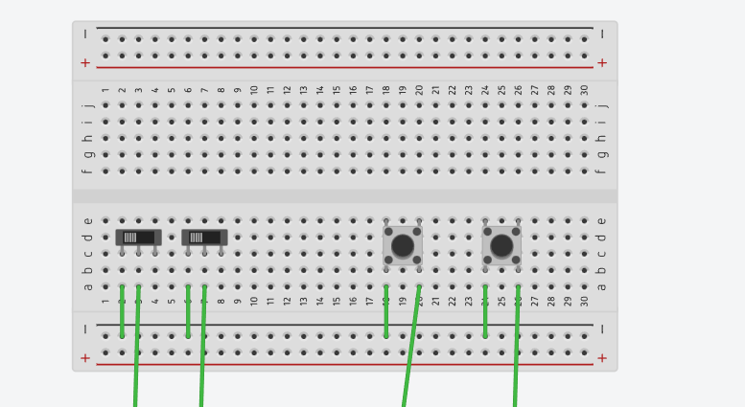
Circuit Topology
Interrupt Buttons
(Jam , Lock , limits)
Upper limiter
Lower limiter
Window Lock
Jam

Slide 18
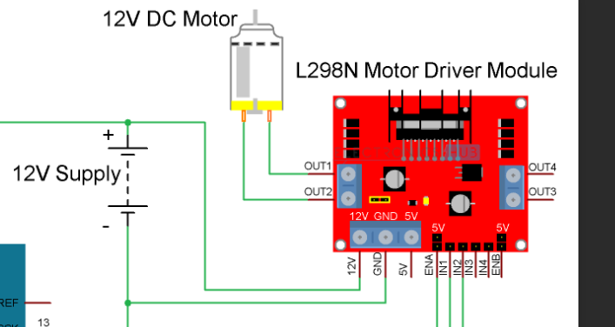
Circuit Topology
L298N Motor Driver Module

Slide 19
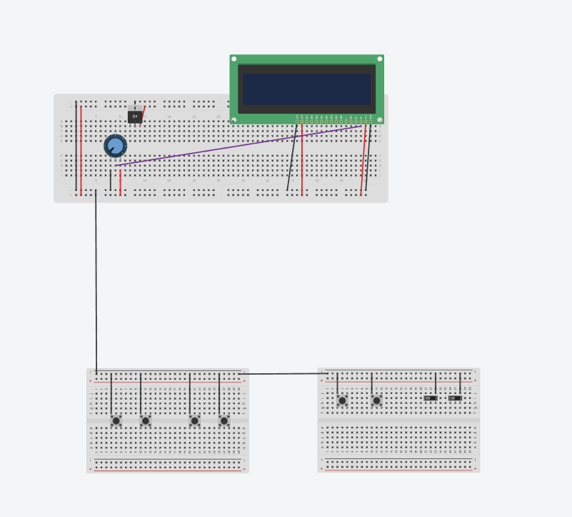

Slide 20
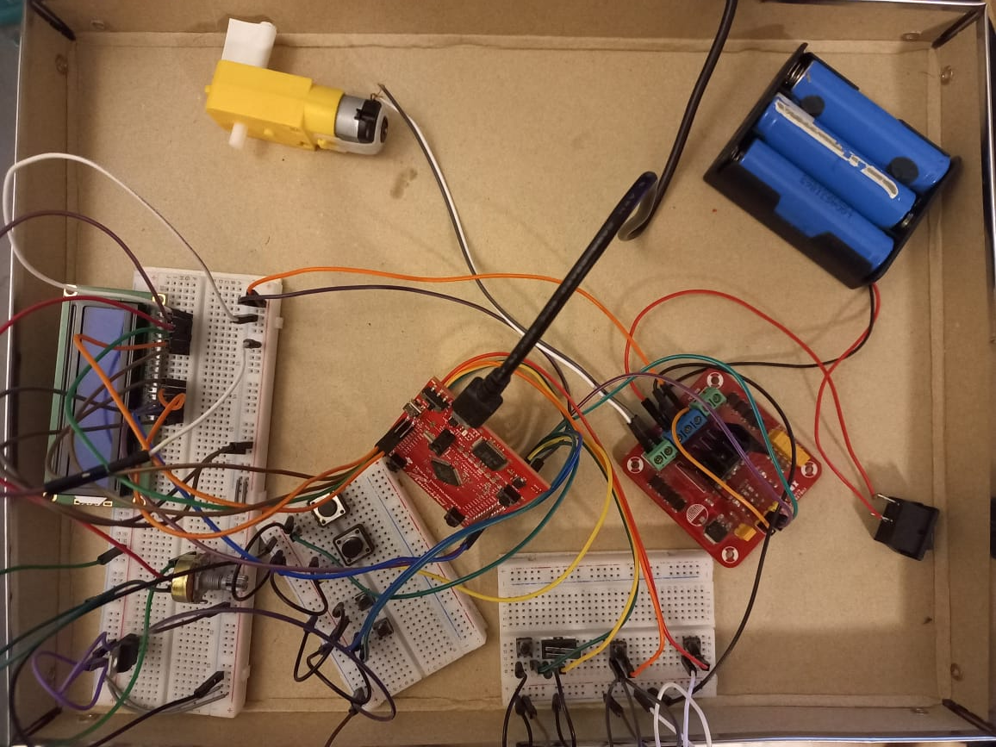

Slide 21
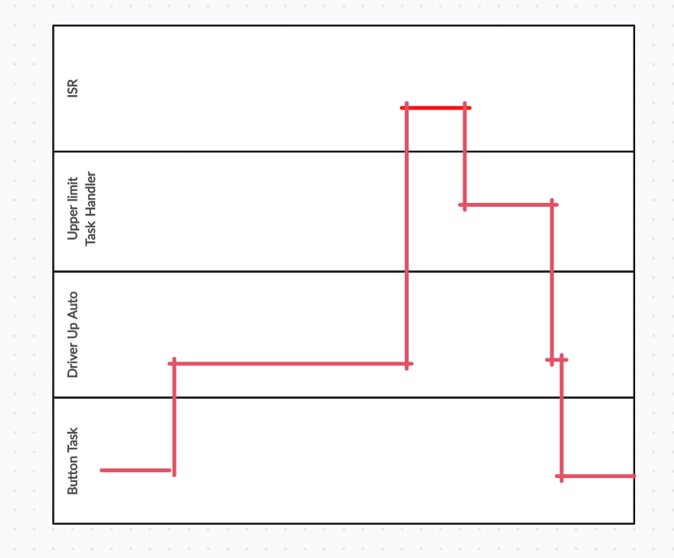
Handling Different Cases Using Timing diagrams
Action :Driver presses up automatic mode , till upper limit reached
A similar timing diagram is for any motion of window by any user interrupted by any sporadic task

Slide 22
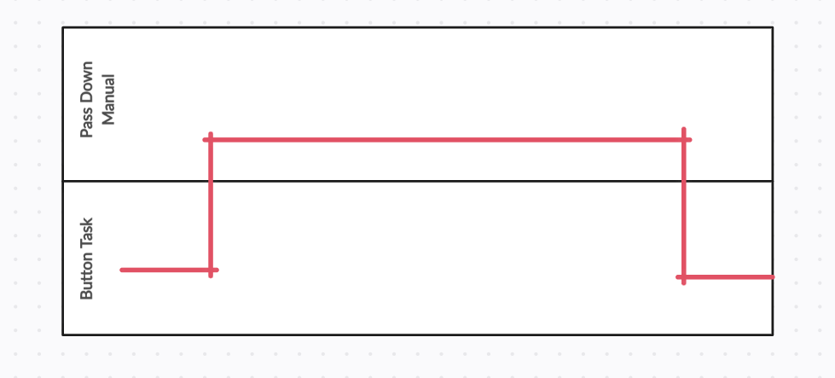
Handling Different Cases Using Timing diagrams
Action: Driver / Passenger pressed button down manually until button is released
A similar timing diagram is for any manual motion of window by any user

Slide 23
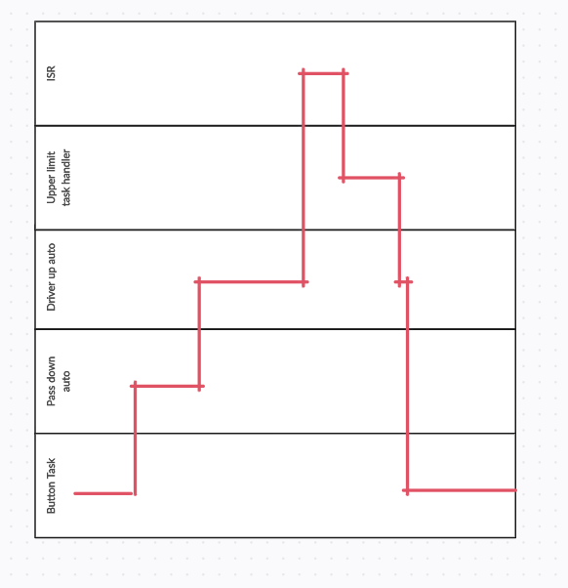
Handling Different Cases Using Timing diagrams
Action: Pass down , driver up , upper limit reached
A similar timing diagram is for any passenger action that it will always be overridden by the driver if he make any action
Passenger task is deleted when we enter driver task

Slide 24
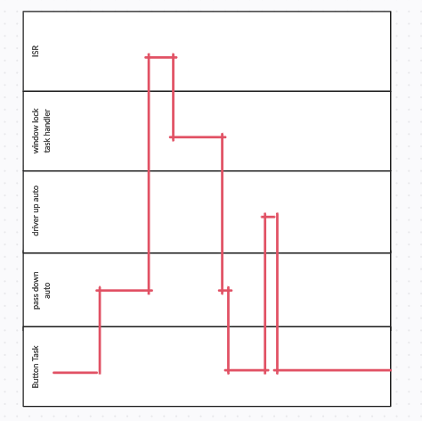
Handling Different Cases Using Timing diagrams
Action: pass down auto , window locked , driver up auto
A window lock will lock the window from any action from any user in any direction

Slide 25
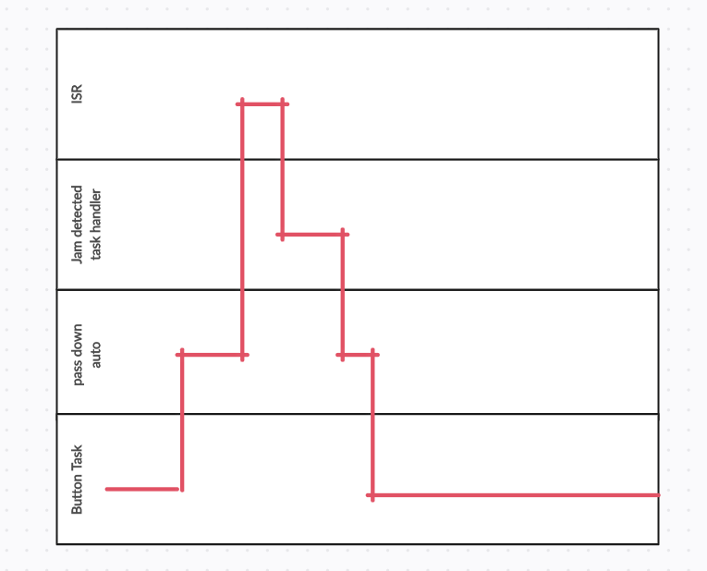
Handling Different Cases Using Timing diagrams
Action: driver up manual , jam detected
Jam detected will cause the motor to move in opposite direction for 500ms inside the task itself

Slide 26
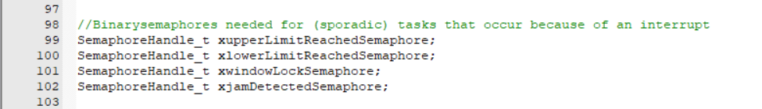
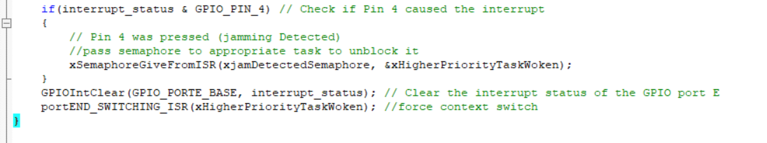
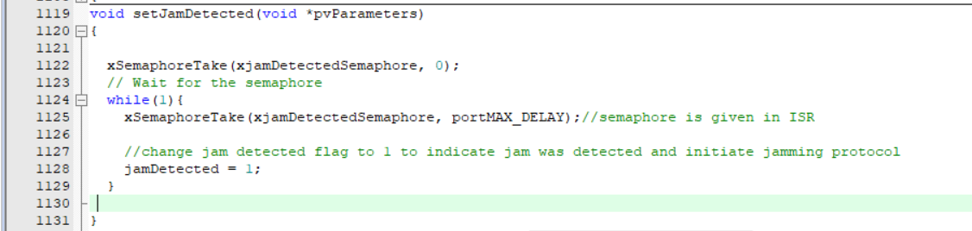
Use of Semaphores
We Used binary semaphore to allow sporadic tasks to happen
Initially these tasks block on taking semaphore
Whenever we enter the ISR , a semaphore is given which unblocks the appropriate task

Slide 27
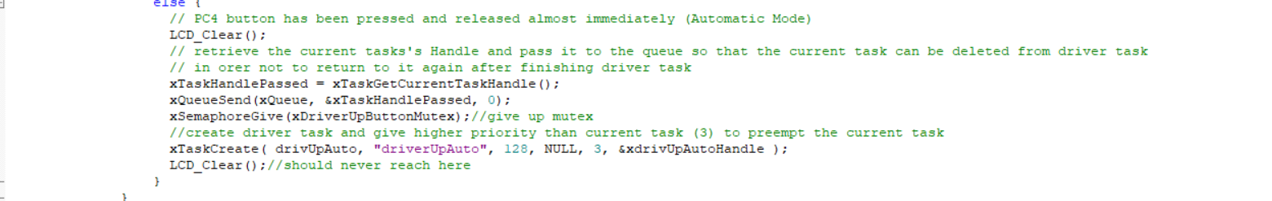
Use of Queues
We used queues to allow task to task communication
So When do we need task communication?
When a passenger task is preempted by a driver task , we send the passenger task handler in a queue to the driver task , and the driver task then receive the handler and delete the passenger task because we don’t want to return to the passenger task again
Inside Passenger Task
Inside Driver Task

Slide 28
Use of Mutex
We Used mutex in our project to protect a critical section shared between the BUTTON Task and Any passenger task , which is detecting if a driver button was pressed or not
Even though it might seem starnge that why would I go back to button task (priority 1) even though I am in a higher priority passenger task (priority 2) but due to vTaskDelay (which blocks) in passenger task , the execution is given to Button task , which can then read also the driver button which will cause faulty readings and unnecessary duplicated actions.
So we use mutex to protect this critical section (detecting driver’s button presses)
Inside Button Task
Inside Passenger Tasks

Slide 29


